Slide 1

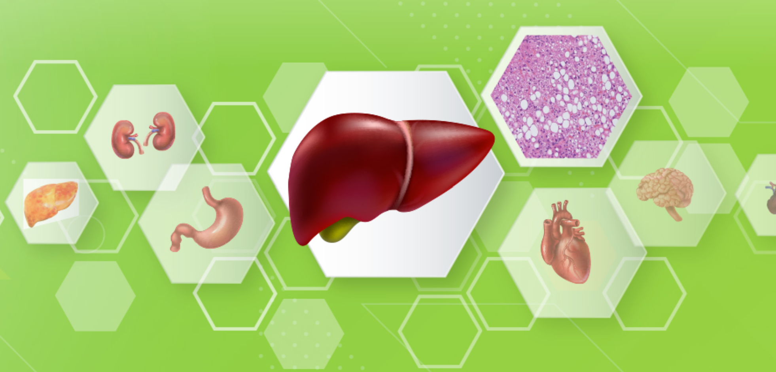


Multi-organ outcomes in MASLD
Dan Yock Young
A/Prof. & Senior Consultant
Div. of Gastro& Hepatology, Dept of Medicine
National University Centre for Organ Transplant
YLL School of Medicine. National University of Singapore
National University Health System
DyCE NUHS, Ceo NTFGH, JCH
Adjunct Faculty, Cancer Science Institute, NUS
Adjunct Faculty, Genome Institute Singapore, A*STAR

Slide 2
COI Disclosure Information
Advisory Board
BMS, Gilead, Novartis, Abbvie, MSD
Education and Research Funding
Gilead, Novartis, Abbvie
Norvo Nordisk, MSD, Siemens
Perspectum, AMRA, Histoindex

Slide 3
Agenda?
Epidemiology of multiorgan involvement in MASLD
Basis of multiorgan involvement – strength of association
Implications of multiorgan systemic disease-
Strategies for screening

Slide 4
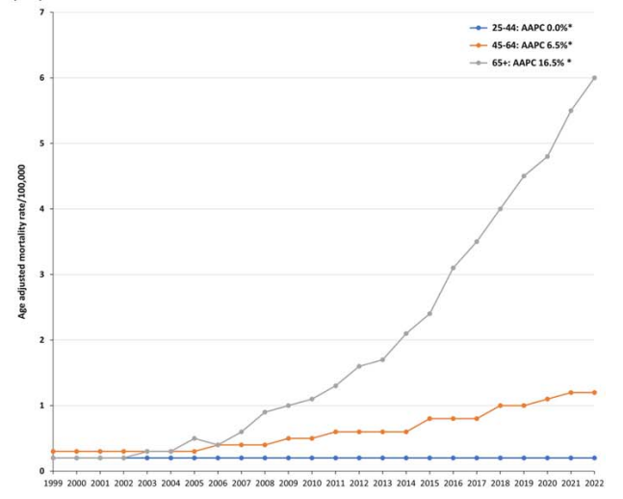
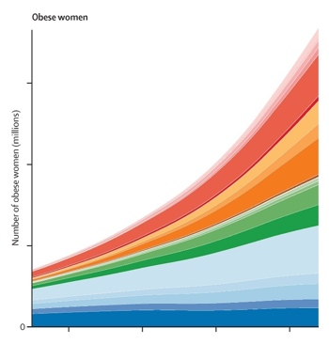
Epidemiology of MASLD
Trends in NAFLD-related mortality from 1999 to 2022 in the United States
Trends of global obesity
East
West
Llyas Hepatology Communications. 2023
The Lancet 2016 387, 1377-1396

Slide 5
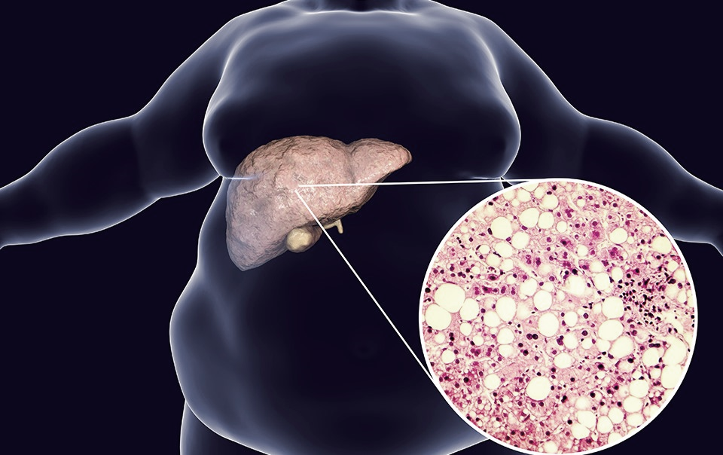
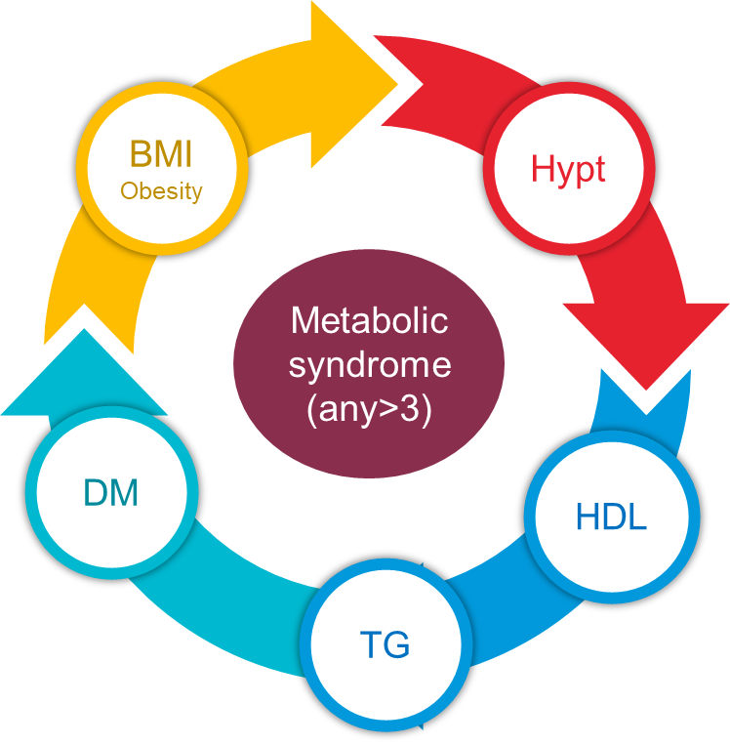
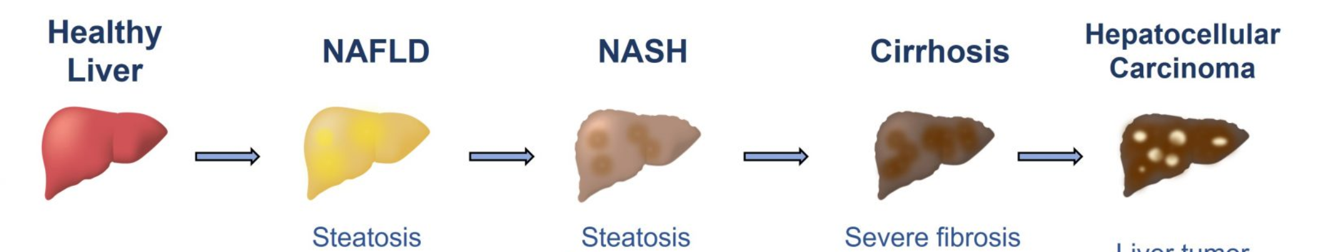

Metabolic-associated steatotic liver disease (MASLD)
Visceral Lipotoxicity
Gut Dysbiosis
Metaboinflammation
Insulin Resistance
Metabolic Flexibility
MASLD
MASH
Notes:
Why NAFLD
NAFLD as part of the metabolic epidemic, will become singularly the number 1 contributer to disease burden in Asia , contributing to 6 out of top 10 NCD
Yet, the field lags behind other diseases in terms of response strategy , mainly driven by lack of disease definition, clinical tools and understanding of biology
Having had the privilege of working on NAFLD in EMULSIOn program over the last 5 years, we are excited that 2 trends will shed light on this condition
Advance in concepts of metabolic syndrome as a systemic low grade inflammation
Availability of multimodality omics which now allows us to build a digital metabolic humanome to guide our understanding and strategy towards MASLD and metabolic disease

Slide 6

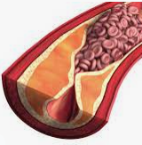


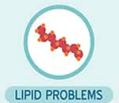


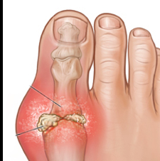

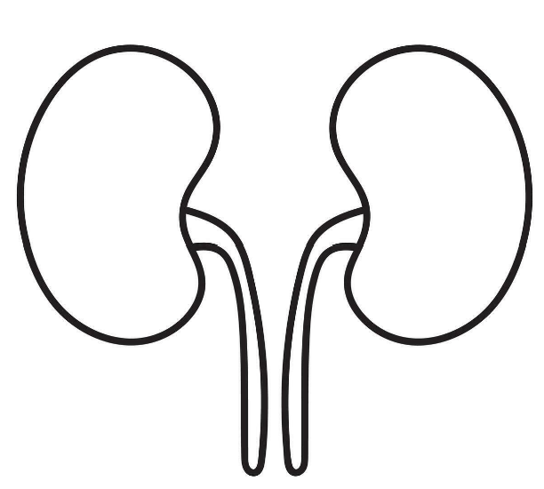
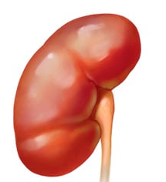
Metabolic-associated steatotic liver disease (MASLD) - a multiorgan disease
Visceral Lipotoxicity
Gut Dysbiosis
Metaboinflammation
Insulin Resistance
Metabolic Flexibility
MASLD
CNS
ATHEROSCLEROSIS
CVD
Cancer
SLEEP APNOEA
GOUT
Aging
Sarcopenia Dementia
DM Cx
ESRF
CKD
Notes:
Why NAFLD
NAFLD as part of the metabolic epidemic, will become singularly the number 1 contributer to disease burden in Asia , contributing to 6 out of top 10 NCD
Yet, the field lags behind other diseases in terms of response strategy , mainly driven by lack of disease definition, clinical tools and understanding of biology
Having had the privilege of working on NAFLD in EMULSIOn program over the last 5 years, we are excited that 2 trends will shed light on this condition
Advance in concepts of metabolic syndrome as a systemic low grade inflammation
Availability of multimodality omics which now allows us to build a digital metabolic humanome to guide our understanding and strategy towards MASLD and metabolic disease

Slide 7
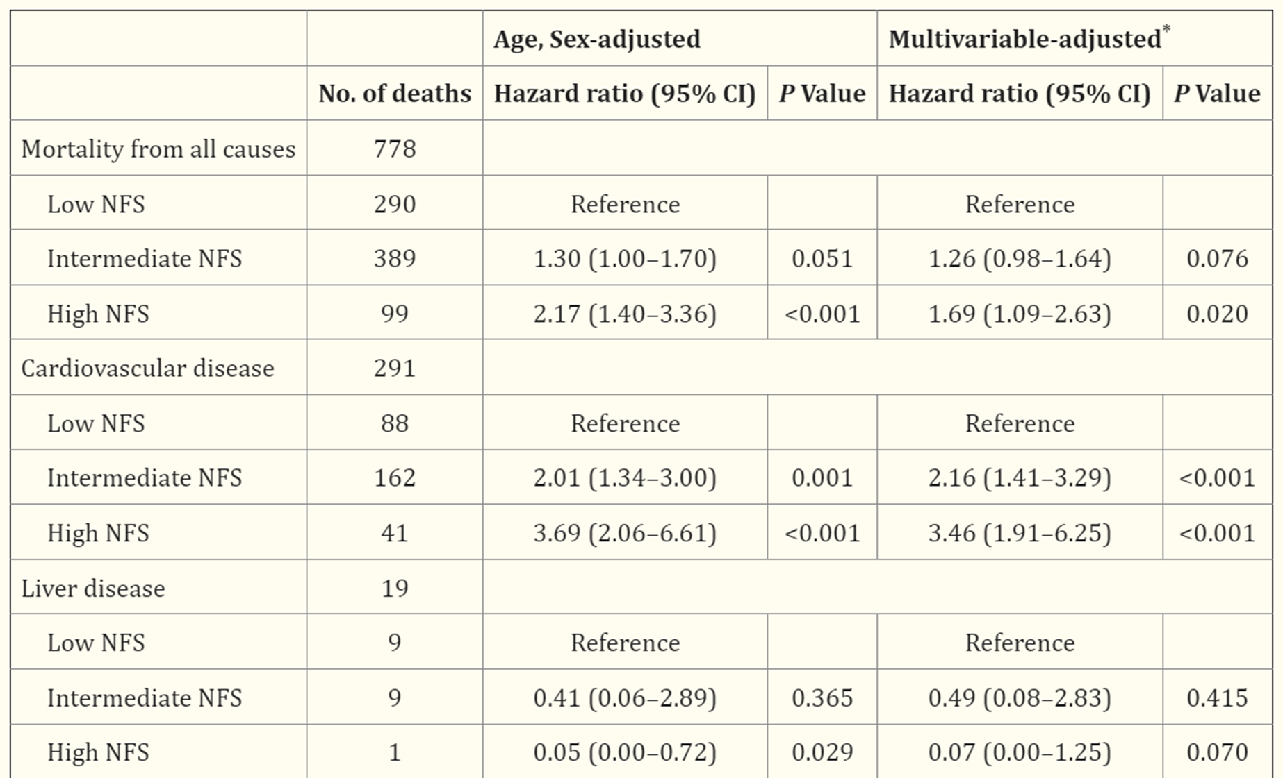
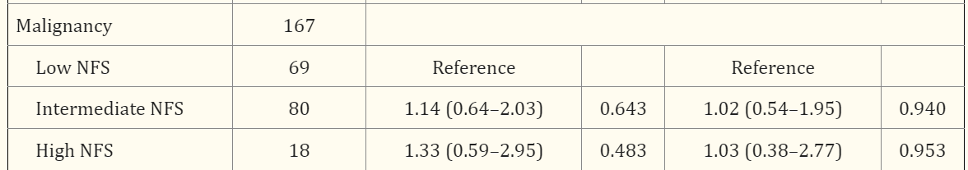
Association between noninvasive fibrosis markers and mortality among adults with nonalcoholic fatty liver disease in the United States
NHANES III n=11K
US diagnosed NAFLD
Kim Hepatology 2013

Slide 8
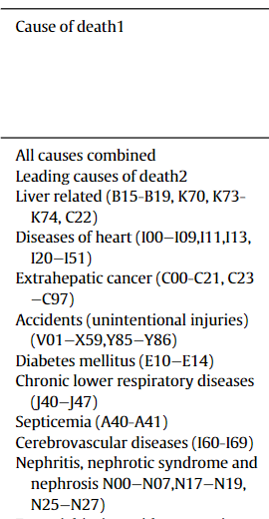
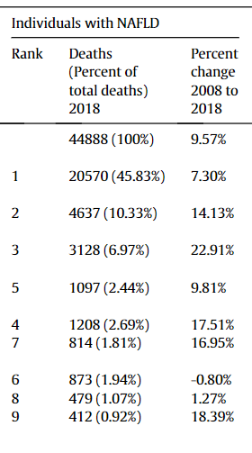
Causes of death in patients with Non-alcoholic Fatty Liver Disease (NAFLD)
National Vital Statistics System (NVSS)
National Center for Health Statistics (NCHS 2008 to 2018. n=45K
Golabi Ann of Hepatology

Slide 9
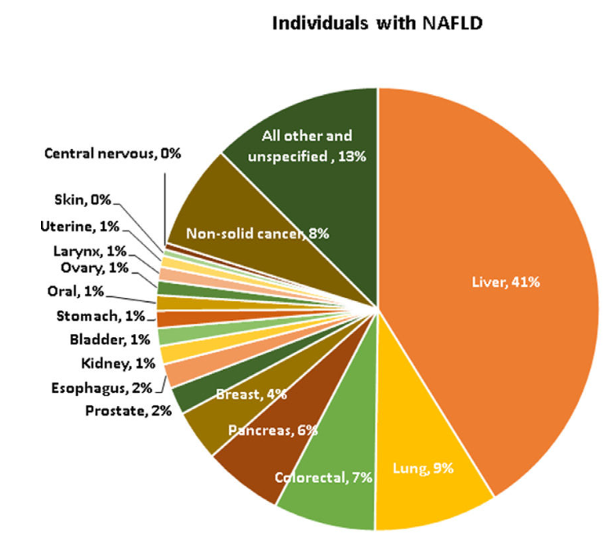
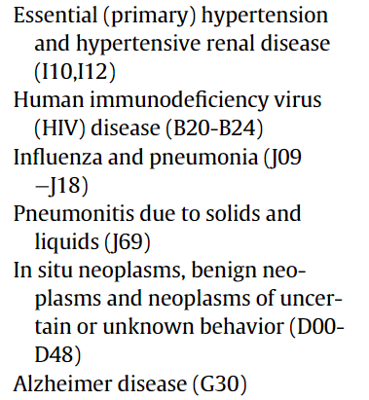
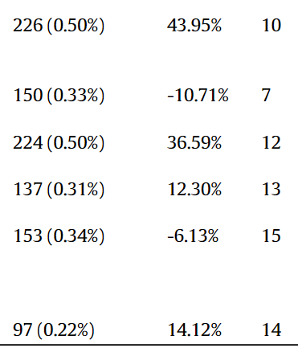
Golabi Ann of Hepatology

Slide 10
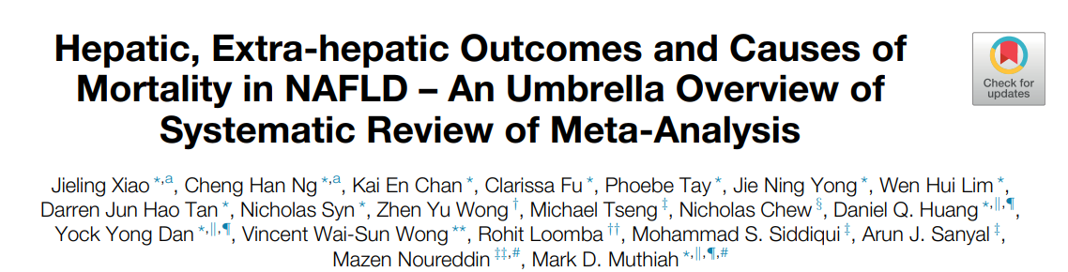
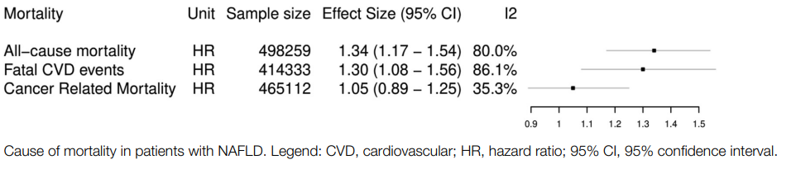
JOURNAL OF CLINICAL AND EXPERIMENTAL HEPATOLOGY
25 metaanalysis
N=5.7M

Slide 11

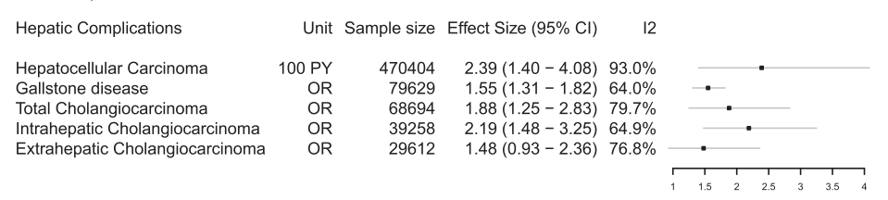
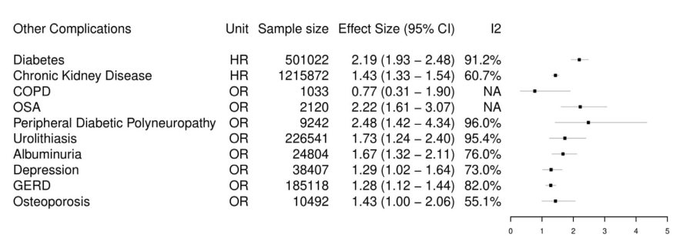
Complications
TIME
Hepatic Complication
Systemic Condition
Notes:
What do we plan to do in INSPIRE
Building on the rich cohorts that we have built, we will layer in 3 additional dimensions of time , space, and biology –
In the first thrust, we seek to define Asian disease trajectory and define patients at risk
Theme 2 dive into spatio-temporal interrogation of metaboinflammation to find ways to disrupt disease progression
tHeme 3 harness the power of Integrative multiomics to define the disease and discover biomarkers and target
6.Our nanogroup experts led by Prof Liu Bin wlll translate Nanodiagnostics and targeting for maximal clinical impact

Slide 12
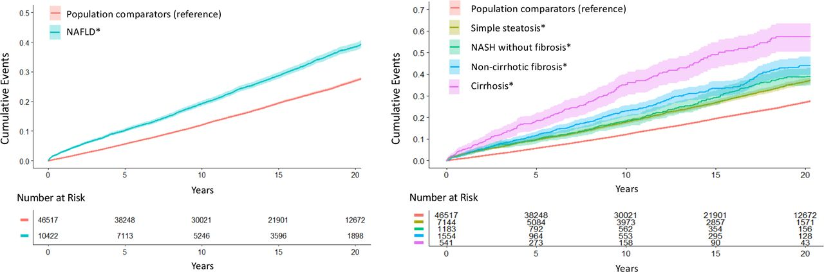
MASLD and Cardiovascular System
Cumulative incidence of MACE outcomes according to the presence and histological severity* of NAFLD. *MACE was defined as a composite endpoint that included incident ischaemic heart disease (including acute myocardial infarction), congestive heart failure, stroke and cardiovascular mortality.
CVD accounts for ~38% of deaths in MASLD
Meta‑analysis HR for MI/stroke: 1.45
↑ risk of atrial fibrillation: HR 1.35
Tracey G Simon et al. Gut 2022;71:1867-1875
Notes:
Cumulative incidence of MACE outcomes according to the presence and histological severity* of NAFLD. *MACE was defined as a composite endpoint that included incident ischaemic heart disease (including acute myocardial infarction), congestive heart failure, stroke and cardiovascular mortality. NAFLD histological severity was defined in four validated categories: simple steatosis, NASH without fibrosis, non-cirrhotic fibrosis and cirrhosis (please see online supplemental appendix). MACE, major adverse cardiovascular event; NAFLD, non-alcoholic fatty liver disease; NASH, non-alcoholic steatohepatitis.

Slide 13
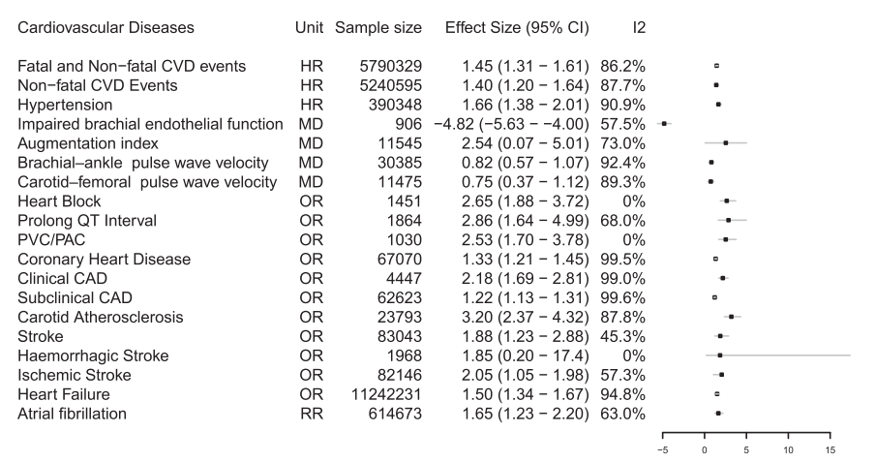
Complications
TIME
Cardiovascular Disease
Notes:
What do we plan to do in INSPIRE
Building on the rich cohorts that we have built, we will layer in 3 additional dimensions of time , space, and biology –
In the first thrust, we seek to define Asian disease trajectory and define patients at risk
Theme 2 dive into spatio-temporal interrogation of metaboinflammation to find ways to disrupt disease progression
tHeme 3 harness the power of Integrative multiomics to define the disease and discover biomarkers and target
6.Our nanogroup experts led by Prof Liu Bin wlll translate Nanodiagnostics and targeting for maximal clinical impact

Slide 14
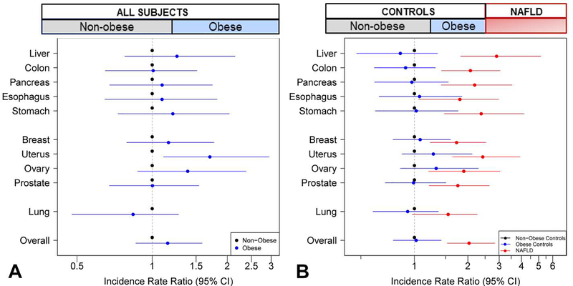
Systemic Maliganancies
MASLD and extrahepatic malignancies
Forrest plot of risk of incident cancers, adjusted by age and sex. A. Obese versus non-obese participants, irrespective of NAFLD status. B. NAFLD versus non-obese controls (red), obese controls versus non-obese controls (blue). Plot shows the incidence rate ratios and 95% confidence intervals.. Incidence rate ratios >1 indicate increased cancer risk.
Allen et al. J Hepatol. 2019

Slide 15
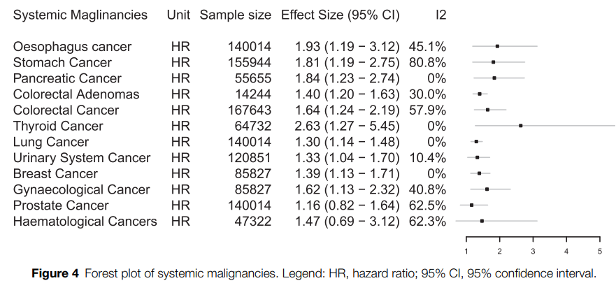
Systemic Maliganancies
MASLD and extrahepatic malignancies

Slide 16
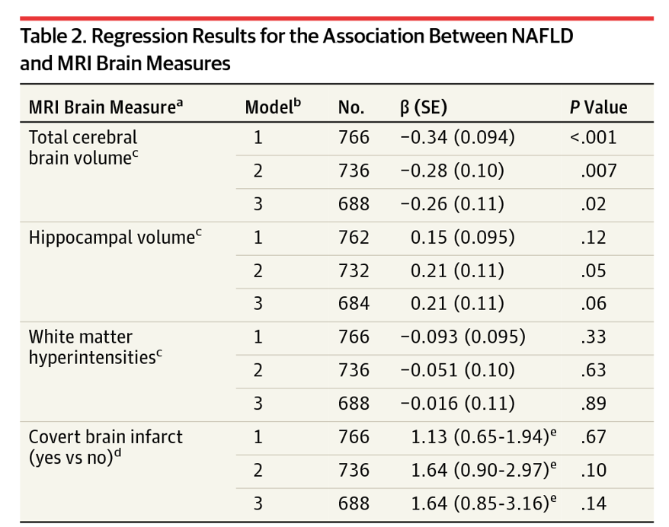
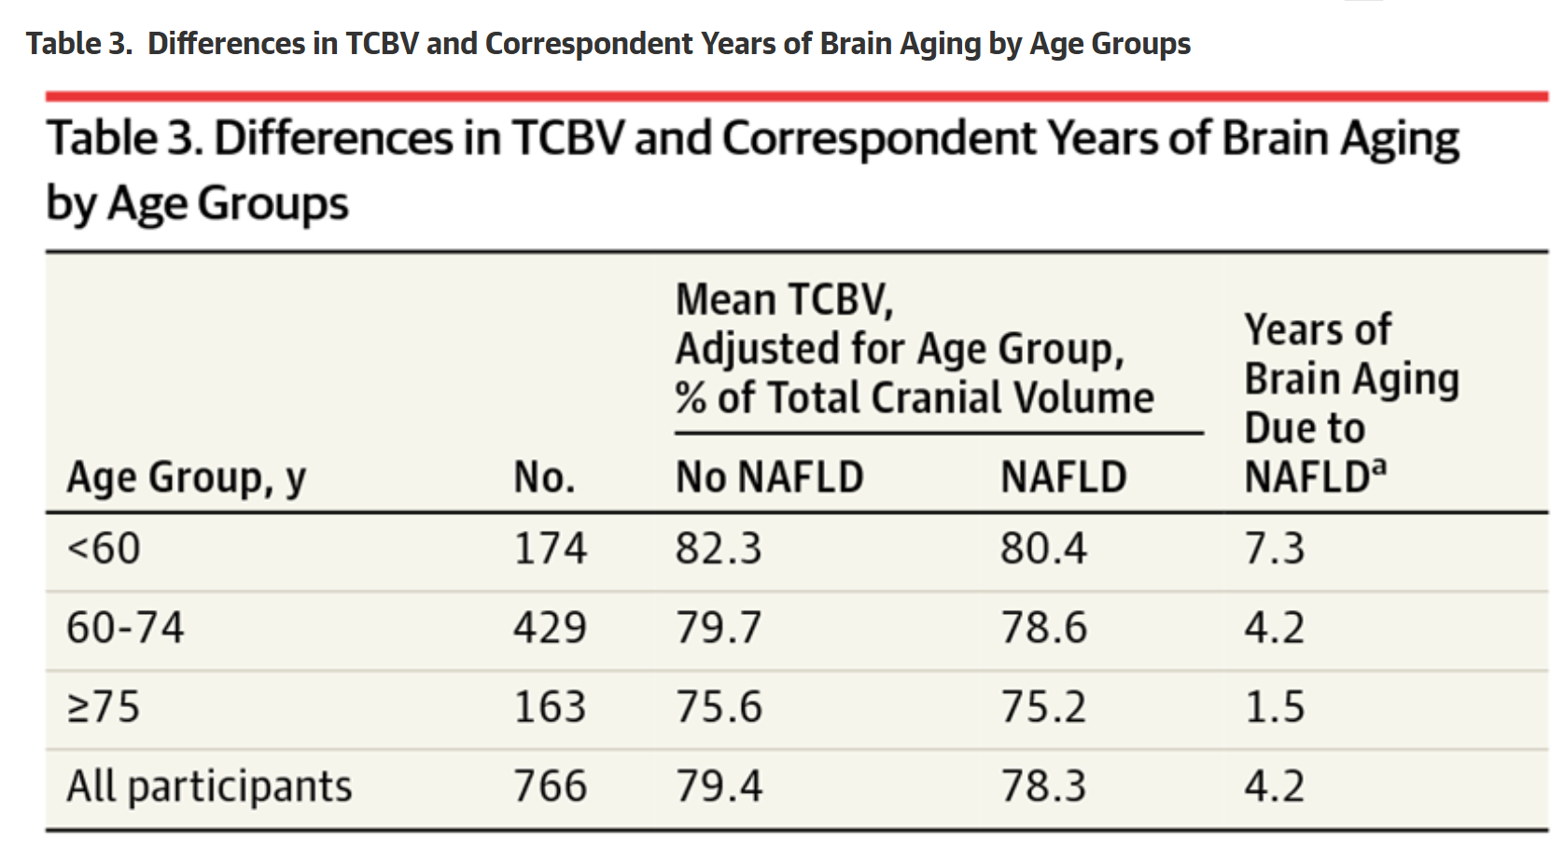
MASLD and Brain
Cognitive decline risk ↑ 1.5× (Weinstein 2018)
White matter hyperintensity volume ↑ in MASLD

Slide 17
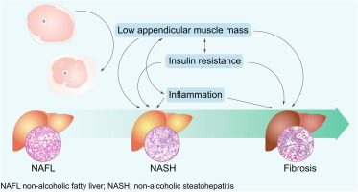
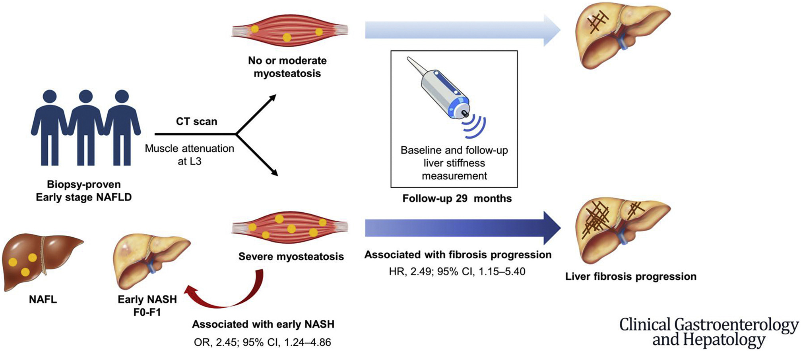
MASLD and Muscle
Severe myosteatosis is significantly associated with early NASH,
Happens before decrease in Skeletal muscle index
Is associated with fibrosis progression in early stage NAFLD.
Hsieh et al. CGH 2023
Koo et al. JHEP 2017

Slide 18
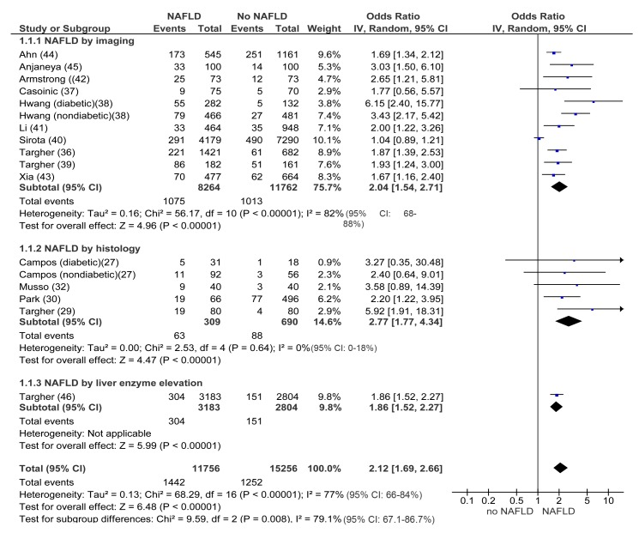
MASLD and Kidney
CKD CKD incidence ↑ 38%HR 1.38
HR for ESRD: 1.79 in advanced fibrosis
Musso et al. Plos Med 2014

Slide 19
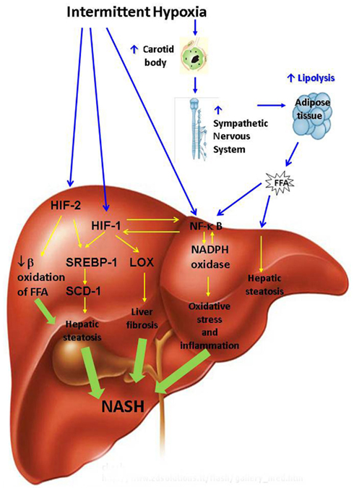
MASLD and OSA
Study (Year) | Exposure & Outcome Definitions | Key Effect Size(s) | Notes
Musso et al., 2013 (Obesity) Systematic review & meta‑analysis of 18 cross‑sectional studies (n=2,183). | OSA by PSG/respiratory polygraphy/oximetry; NAFLD by histology, imaging, or enzymes. | Presence of NAFLD with OSA: Histology OR 2.01 (95% CI 1.36–2.97); Imaging OR 2.99 (1.79–4.99); Elevated AST OR 2.36 (1.46–3.82); Elevated ALT OR 2.60 (1.88–3.61). In biopsy‑proven NAFLD: NASH OR 2.37 (1.59–3.51); Any fibrosis OR 2.16 (1.45–3.20). | Associations independent of age, sex, and BMI on meta‑regression. Advanced fibrosis also increased (value reported as OR≈2.3; CI truncated in author PDF).
Jin et al., 2018 (Sleep & Breathing) Systematic review & meta‑analysis (9 studies; n=2,272). | OSA vs non‑OSA; outcomes included ALT/AST and histology (steatosis, lobular inflammation, ballooning, fibrosis). | Higher ALT with OSA (severity‑dependent); significant associations with steatosis, inflammation, ballooning, and fibrosis (pooled ORs not uniformly reported in abstract). | OSA was independently related to NAFLD development and progression; AST not consistently elevated.
Tang et al., 2023 (Frontiers in Endocrinology) — narrative review summarizing pooled data | Summarizes multiple cohorts/meta‑analyses. | Reported that patients with OSA show ALT +13.3% and AST +4.4% vs controls; NAFLD patients with OSA have ~2.6‑fold higher risk of liver fibrosis. | Also highlights severity gradients (AHI/ODI) correlating with liver injury and fibrosis independent of BMI.
Umbro et al., 2020 (World J Gastroenterol) Systematic review (13 studies; n=2,753 in qualitative analysis). | OSA (PSG) and NAFLD by imaging/biopsy; also reviewed CPAP effects. | Increased prevalence/severity of NAFLD with OSA; CPAP may stabilize/slow progression and improve aminotransferases/steatosis (no uniform pooled effect size). | Recommends routine OSA screening in NAFLD and vice‑versa.
Ma et al., 2025 (Nature & Science of Sleep) — Mendelian randomization Two‑sample & network MR using large GWAS (FinnGen OSA; European MAFLD/NAFLD cohorts). | Genetic liability to OSA → MAFLD; BMI mediation tested. | Causal estimate: OR 1.40 (95% CI 1.14–1.73; p=0.002) for OSA increasing MAFLD risk; ~62% of effect mediated via BMI. | Genetic evidence supports a partly BMI‑mediated causal link OSA → MAFLD.
2.6-fold higher risk of liver fibrosis.
Increased ALT and AST levels.
Strong correlation between OSA severity and NAFLD activity score (NAS)

Slide 20
Organ complicaetions: Lean vs Obese MASLD
Parameter | Lean NAFLD | Obese NAFLD
BMI | <25 kg/m² (Asia: <23 kg/m²) | ≥25 kg/m² (Asia: ≥23 kg/m²)
Metabolic Comorbidities | Fewer (less diabetes, hypertension) | More prevalent
Histological Severity | Higher rates of NASH and cirrhosis | Lower rates of advanced fibrosis
All-Cause Mortality | Higher (RR ~1.39 vs. obese NAFLD) | Lower | Ye Q et al., Hepatology 2020 Nguyen MH et al., J Clin Transl Hepatology 2023
Liver-Related Mortality | Comparable or slightly higher | Comparable
Cardiovascular Mortality | Similar | Similar | Danpanichkul. Clin Mol Hepatol. 2025
Cancer Incidence | Similar. ? Higher risk of HCC | Similar

Slide 21
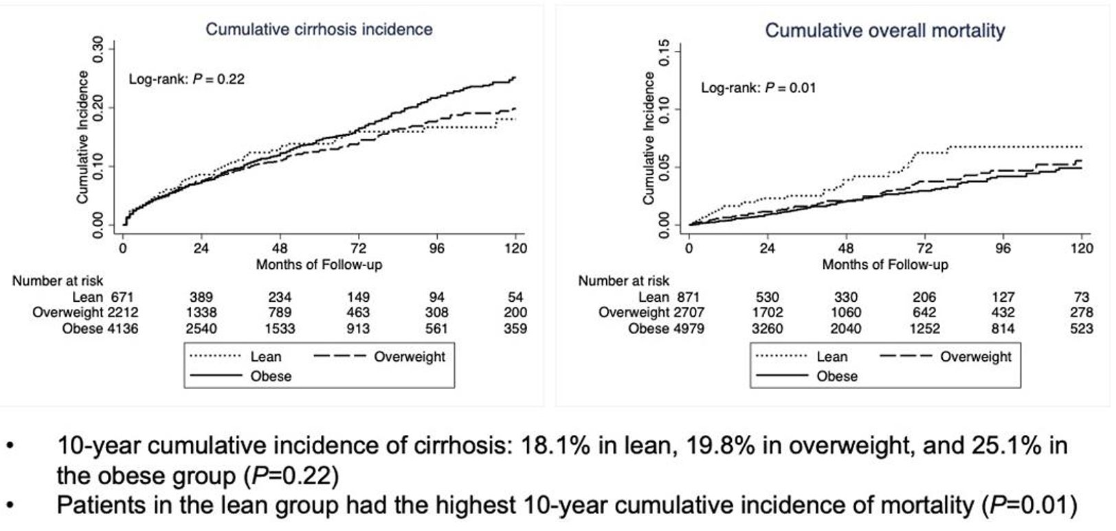
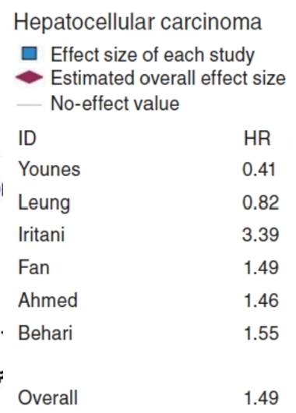
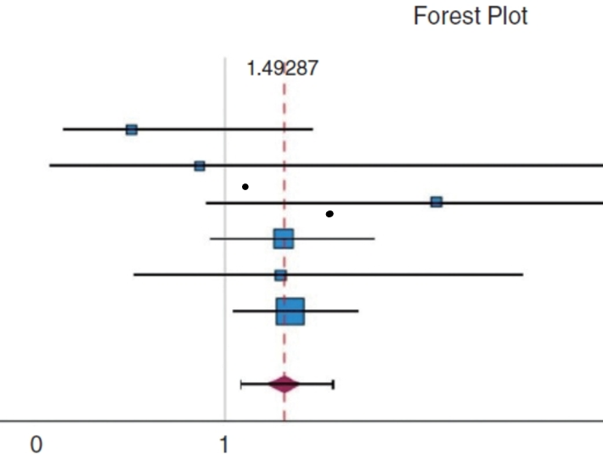
Lean vs Non-lean MASLD
Lean MASLD: 13% prevalence
Higher HCC risk in lean (HR 1.8) vs non‑lean
Lean NAFLD patients had higher all-cause mortality than non-lean NAFLD patients:RR = 1.39 (95% CI: 1.08–1.82), heterogeneity I² = 43%.
Danpanichkul. Clin Mol Hepatol. 2025
Nguyen MH et al., J Clin Transl Hepatology 2023

Slide 22
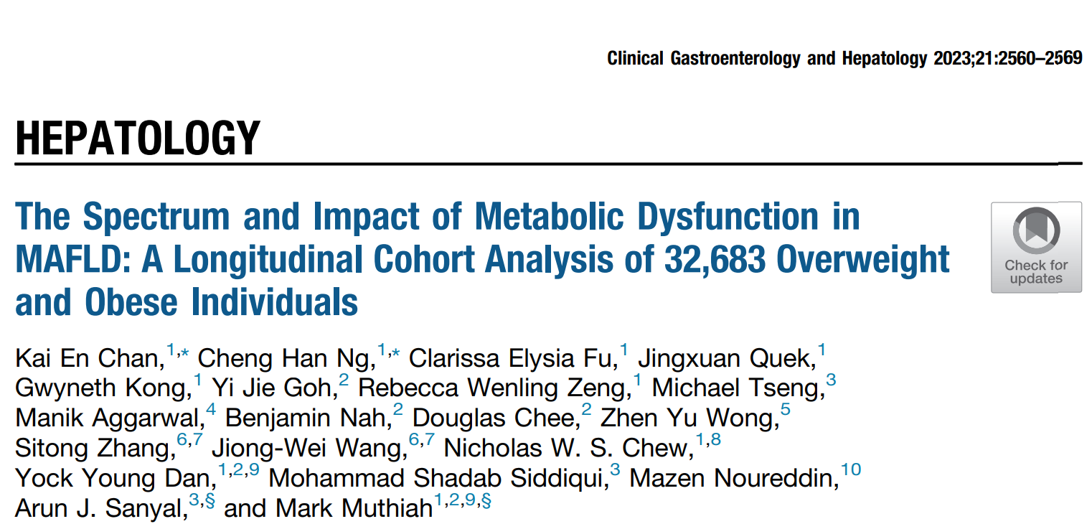
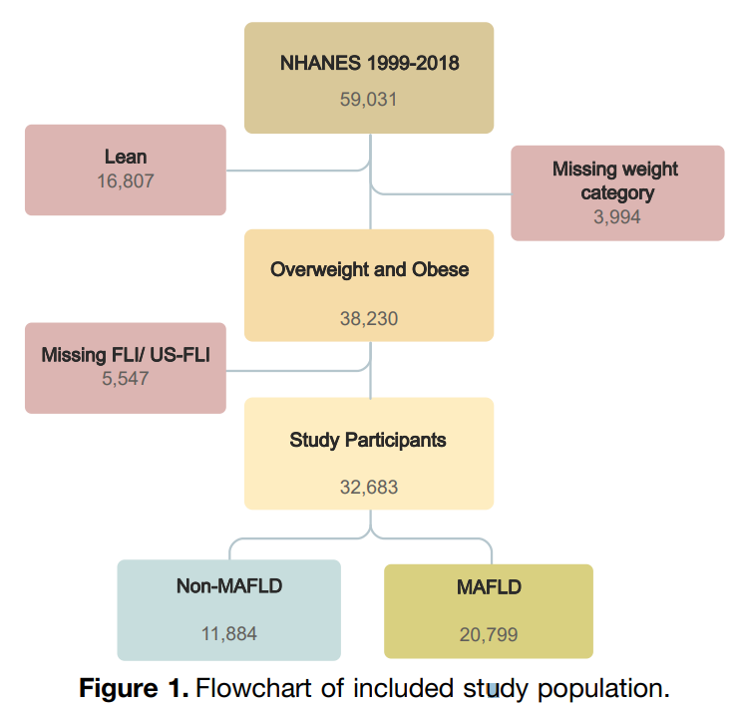
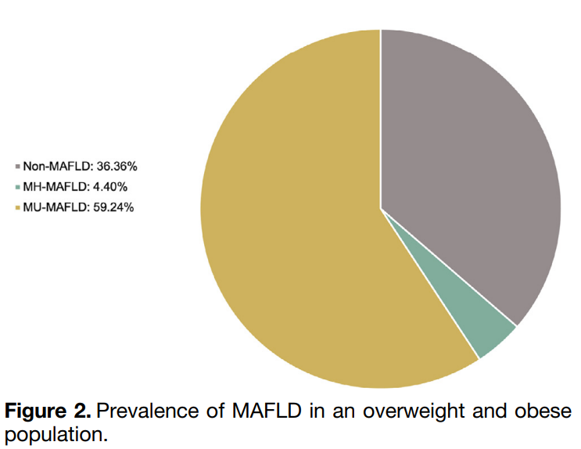
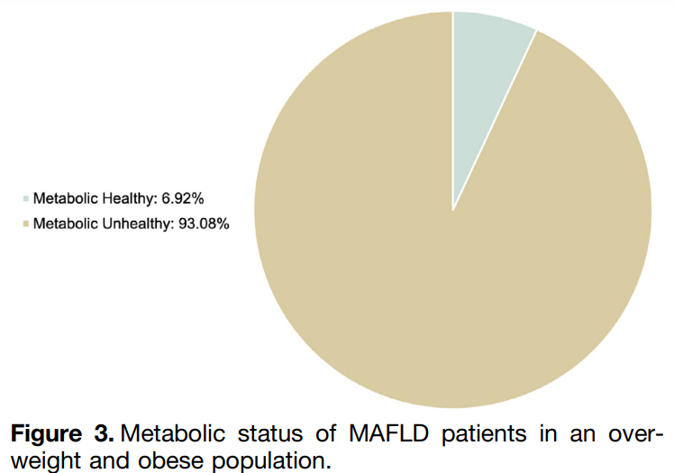
Which are the subgroups in MAFLD that are at increased risk of MACE and extrahepatic malignancies?
Chan et al

Slide 23
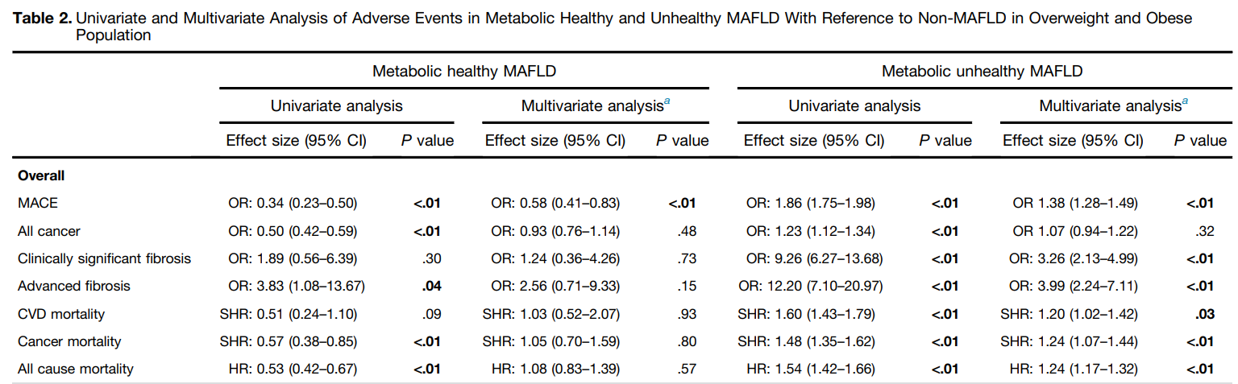

Slide 24
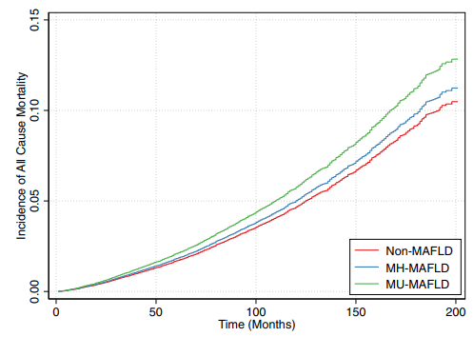
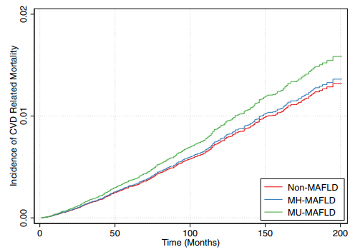
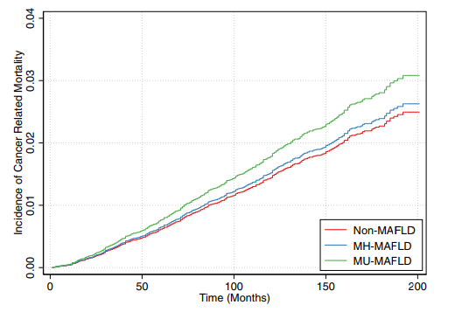

Slide 25
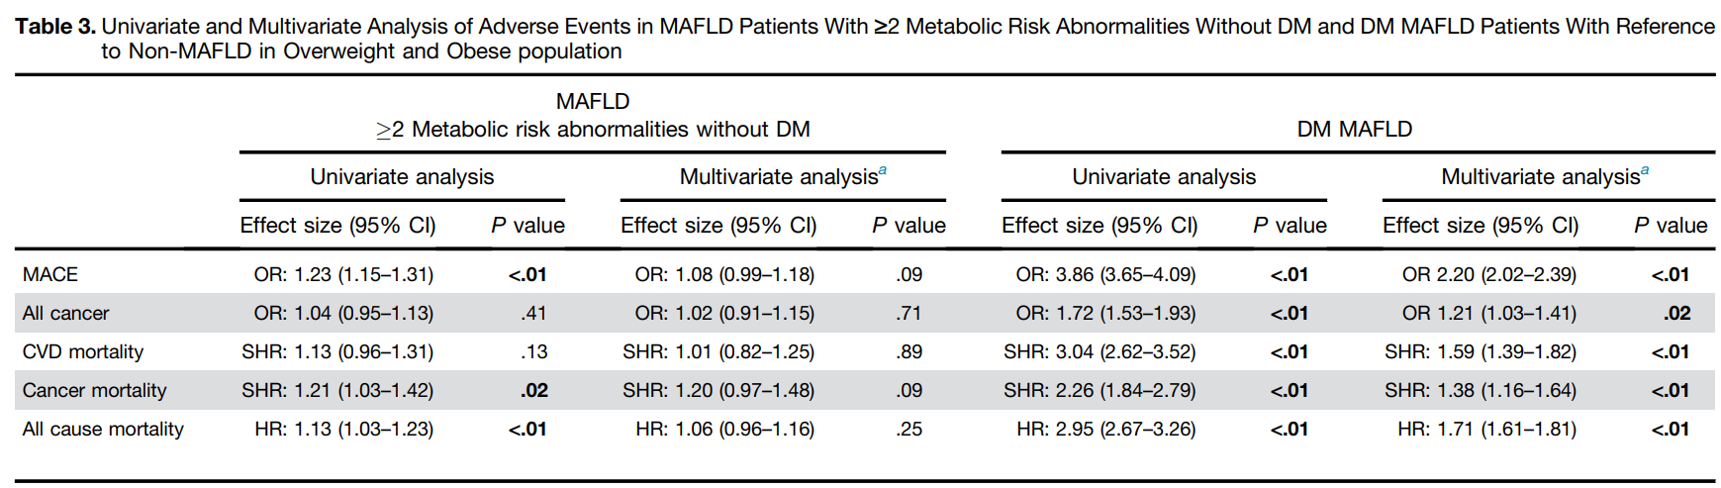

Slide 26
Summary
MAFLD is associated with myriad of complications and increased risk of mortality through multisystem involvement
Patients with MAFLD are at increased risk of liver complications, cardiovascular and extrahepatic cancer
The risk appear to be highest amongst MAFLD patients who are metabolically unhealthy (DM or >2 metablic complications)
Understanding the high risk groups carries significant implications for targeted screening and preventive intervention

Slide 27

Acknowledgements
Lab
Nur Halisah
Zhou Lei
Sekina
Clinician Scientist
Mark Muthiah Jonathan Lee
Daniel Huang
Ng Huck Hui
Ramunaj Gupta
Alexander Lezhava
Mei Chin
Winston
Collaboarator
Hanry Yu
Lim Chwee Teck
Christine

